Slide 1
Learning Session 1
Overview of ‘M’(measure) from the D-M-A-I-C Model

Slide 2

The presence of the Laboratory African Regional Collaboration (LARC) logo on slides
indicates that content (in whole or in part) originates with the LARC Program

Slide 3
Guiding Principles for Quality Improvement
Focus on the needs of the users
Focus on processes to increase the productivity of work
Use data to improve services
Use teams to improve quality
Improve communication
LARC Workbook, p. 6
https://www.larccqi.org/uploads/resources/LARC-3.0-WORKBOOK.pdf
LARC Workbook

Slide 4
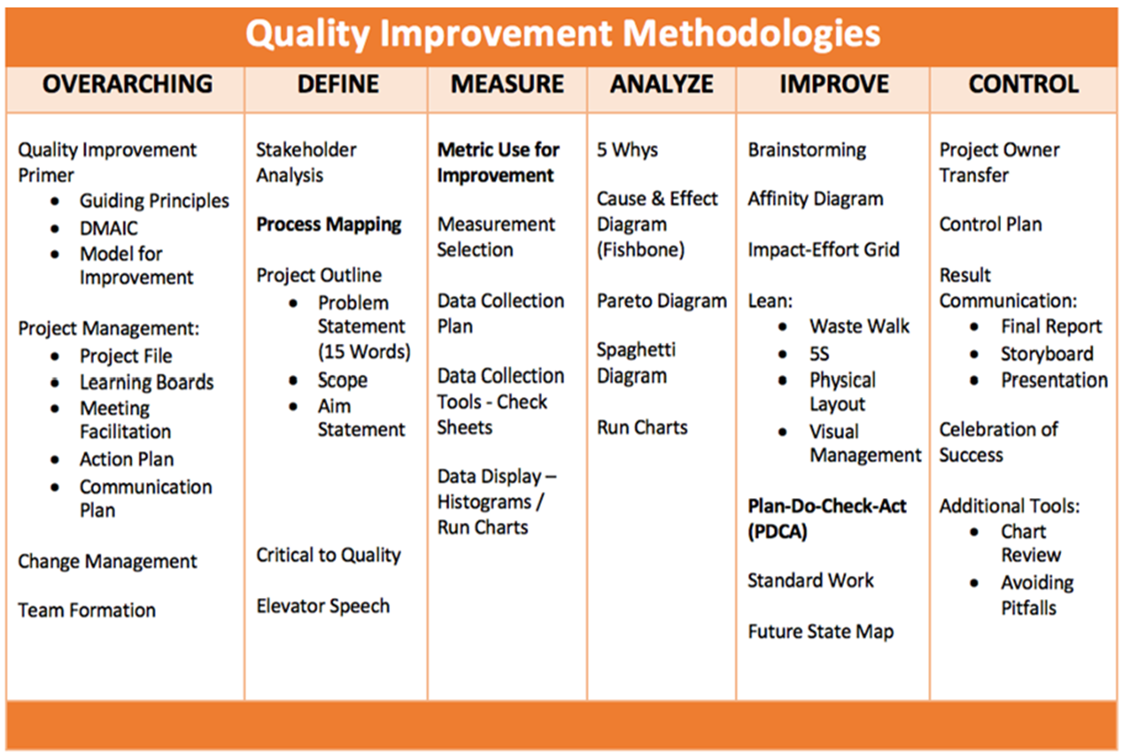
LARC Workbook

Slide 5
Using Metrics for Improvement
Metric Selection
Data Collection Tool/s
Data Collection Plan
Data Display
LARC Workbook, p. 48-55
https://www.larccqi.org/uploads/resources/LARC-3.0-WORKBOOK.pdf
LARC Workbook

Slide 6
Deliverables
Metric Selection
Data Collection Tool
Data Collection Plan
Data Display
LARC Workbook, p. 48-55
https://www.larccqi.org/uploads/resources/LARC-3.0-WORKBOOK.pdf
LARC Workbook

Slide 7
Metrics – WHY?
Evidence-based, objective criteria for decision making
Evidence of actual improvement - Gauge of project success – How will you know if a change is an improvement?
Results - What gets measured, gets fixed.
Visual
  Graphs tell a story
  Outcomes & goals that are not made visual will fail
LARC Workbook

Slide 8
Why Collect Data?
To establish a factual basis for making decisions
“I think the problem is…”
“The data indicates the problem is…”
vs
Opinion Driven Decisions
Data Driven Decisions
vs
LARC Workbook
Notes:
Data is needed to focus improvement efforts
Objective data is needed to make sound judgments.
Data from time studies, equipment loading data, takt times, staffing requirements, process yields, and lot and kanban sizing information will lead to workflow configurations and process layouts that help optimize value streams.
Good data collection forms organize information into useful formats, serve as communication tools, and help trigger solid improvement efforts.

Slide 9
Ask 3 Questions: The Model for Improvement
AIM
What are you trying to accomplish?
METRIC
How will you know if a change is an improvement?
CHANGE
What change will you make that will result in an improvement?
LARC Workbook

Slide 10
“What gets measured, gets fixed.”
DATA
LARC Workbook

Slide 11
Metrics – When?
Define/ Measure
  Problem Statement – the magnitude of the problem
  Aim Statement – the project goals & outcomes
Analyze
Improve
  Question #2 – How will you know if a change is an improvement?
  Question #3 - Which change will you make that will result in an improvement?
Control
  Monitoring over time
  Assuring long-term sustainability
LARC Workbook

Slide 12
Types of Measures
INPUTS
Input #1
Input #2
Input #3
Process Step
A
Process Step
B
OUTCOME
Process Step
C
Input Measures
Process Measures
Outcome Measures
Counterbalance Measures
LARC Workbook
Notes:
You can select measures for inputs and outputs for the ED Simulation
Inputs – Patients, Supplies, Staff, Physical Structure
Outputs – # Patients treated, Patient satisfaction,
Process steps – Time, Quality of step

Slide 13
Metric Selection
“Measure what matters”
LARC Workbook
Notes:
Data to align with strategic goals
Data that is available and valid
Data with an available benchmark / comparison data

Slide 14
Metric Selection
Searching for the “Holy Grail” – The Ideal Metric
  Measure the outcome - what the project is attempting to accomplish
  Be powerful
  Be meaningful
  Be realistic or easy to collect
Metric Selection Questions (See Model for Improvement – 3 Questions)
LARC Workbook

Slide 15
What are some things that you can measure?
Time, i.e., length of stay, TAT, wait-time, or time between episodes
Defects (Errors)
Counts - i.e., numbers of patients or _________
Scores, i.e., Satisfaction
Efficiency
Productivity
Safety
Compliance
Cost
Value
Throughput / Flow
Access
LARC Workbook

Slide 16
Getting to your aim statement and metric
Accomplish?
Measure?
Accomplish?
Measure?
An iterative process
LARC Workbook

Slide 17
Getting to your aim statement and metric
Accomplish?
Measure?
Accomplish?
Measure?
Goal = All presumptive TB patients screened / identified
Can I measure that given the time frame of this project?
An iterative process
Goal = All tested presumptive TB patients get results
What does that mean?
How am I going to measure that?
What is my numerator & denominator?
LARC Workbook

Slide 18
Key Elements of a Metric
NUMERATOR
DENOMINATOR
LARC Learning Session I PowerPoint

Slide 19
Where to find data?
Data present currently, sources could include:
  Data bases
  Ongoing projects
  Ministry of Health – Written log or electronic records
  Partners/NGOs
Data not present, must collect:
  Data Collection Log – Create & Modify
  Data Collection Plan – Details
    What / How / When / Who

Slide 20
Creating a Data Collection Log
(# patients placed on IPT)
METRIC =
(# HIV patients presented in clinic for the period)

Slide 21
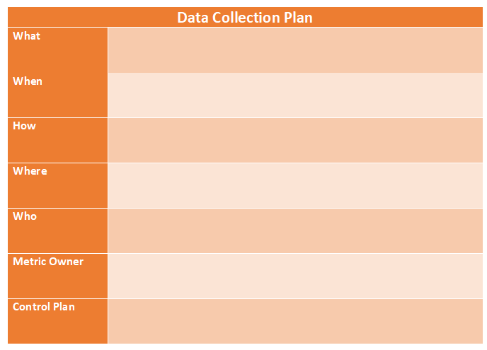
Creating a Data Collection Plan - Template
LARC Workbook

Slide 22
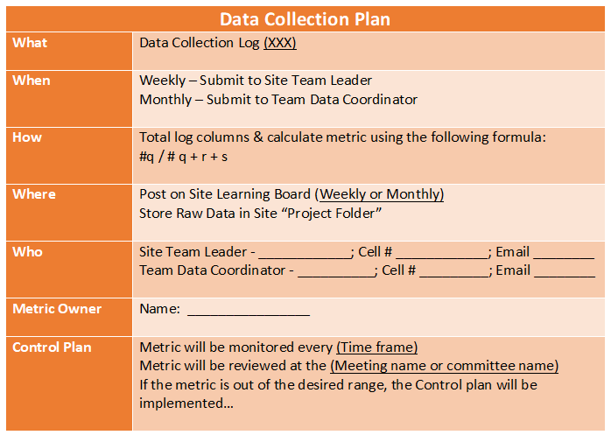
Data Collection Plan - Example
LARC Workbook

Slide 23
Deliverables
Metric Selection
Data Collection Tool
Data Collection Plan
Data Display
LARC Workbook, p. 48-55
https://www.larccqi.org/uploads/resources/LARC-3.0-WORKBOOK.pdf
LARC Workbook

Slide 24
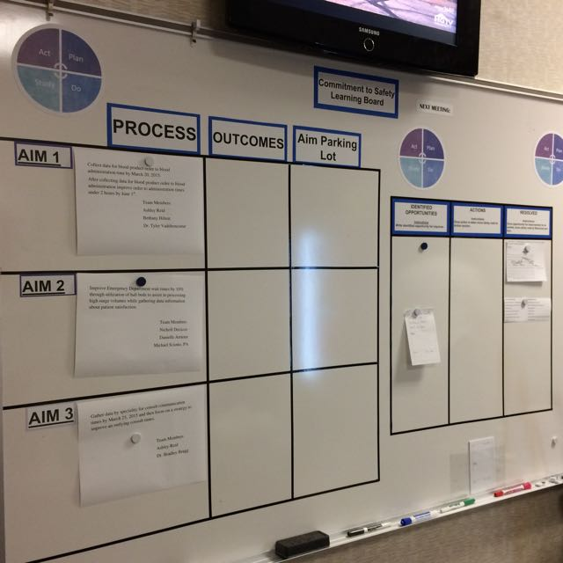
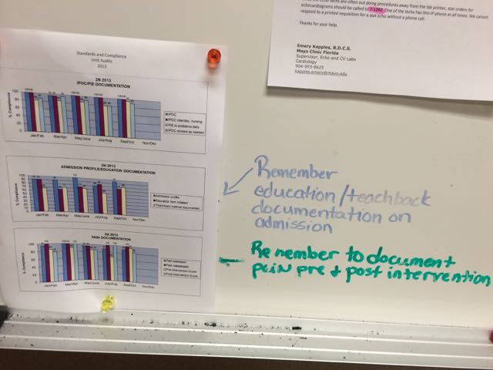
Coming Attractions: Data Display
Be transparent – display data prominently
LARC Workbook

Slide 25


Slide 26


Slide 27
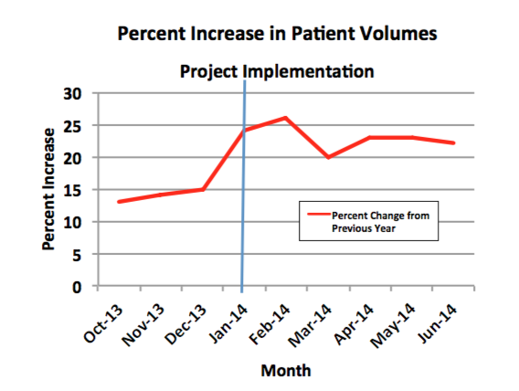
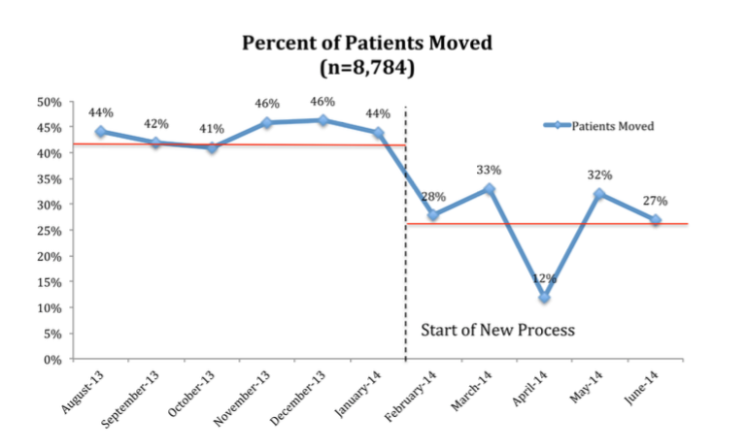
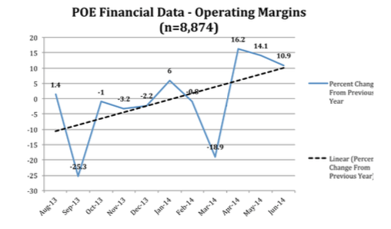
Coming Attractions: Creating a Run Chart
Workbook, p. 55
https://www.larccqi.org/uploads/resources/LARC-3.0-WORKBOOK.pdf
LARC Workbook

Slide 28
Coming Attractions: Data Display
Act on information
LARC Workbook

Slide 29
Questions?

